Slide 1
Version Control (with Git)
Software Design for Data Science
Naomi Alterman
University of Washington
January 5, 2026

Slide 2
When to ask questions
Trick question! Always ask questions.
Especially for projects
However, for questions related to homeworks:
Class discussion forum only (don’t make a post on Stack Overflow)
Don’t provide direct code from your homework in your questions
Don’t provide direct code from your homework in your answers
Notes:
One of the most common ways that I’ve seen interns and new engineers struggle and fail is by not asking questions.
There is never a time in this class where you cannot ask a question.
There’s a difference between "asking a question about your homework" and "asking a specific question about the code and concepts in your homework" - prefer the latter.

Slide 3

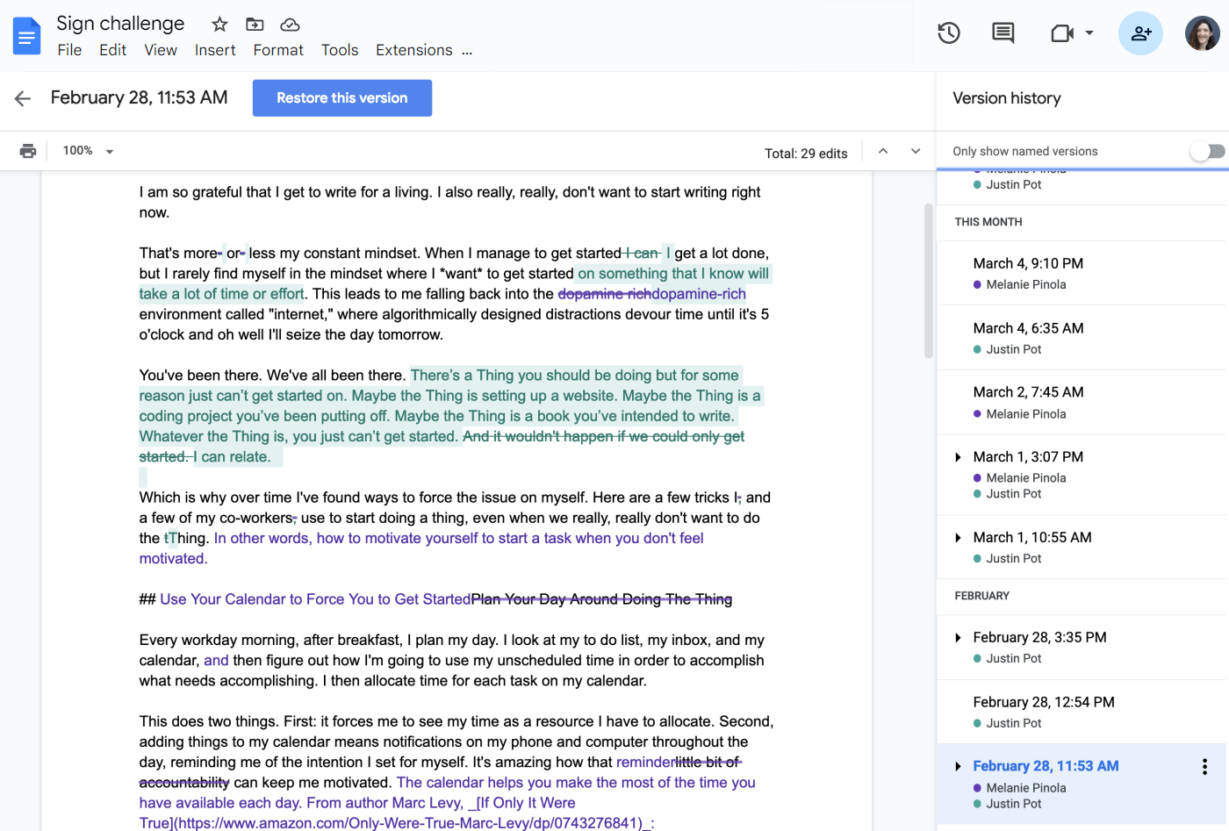
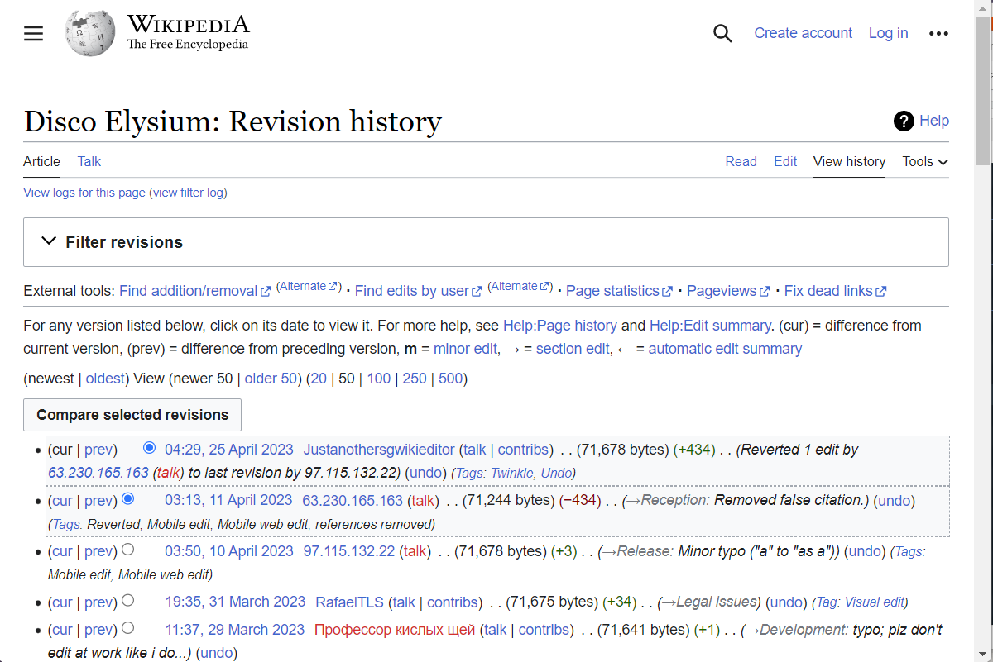
Revisions
Notes:
Google docs (illustrates revision history)
Wikipedia history (illustrates asynchronous editing, change annotations)
PhD comic (Named versions)
Image credits:
https://zapier.com/blog/google-docs-revision-history/

Slide 4
“Version control systems”
Tools to keep track of changes over a collection of documents, called repositories (or “repos”)
Distinguish between “plaintext” and “binary files”
Plaintext – Text and numbers, no formatting. “.txt” files, “.csv” files
Binary – Word docs, Excel sheets, JPEG images
Designed for asynchronous collaboration on plain text
Spectacular at tracking and reconciling differences between subtly different versions of plaintext
Competent at taking “snapshots” of binary files across time, but bad at understanding how they’ve changed

Slide 5

Git
One particular standard for how to do that change tracking
There are a lot of different websites and applications (“clients”) that can work with git repos!
Notes:
Image from: https://www.historytoday.com/miscellanies/scribe-egyptian

Slide 6





Naomi’s favorite git clients
Git (Free, but no graphical interface) https://git-scm.com/
Sublime Merge ($$$, but you can run the trial indefinitely??) https://www.sublimemerge.com/
GitFiend (Free…..for now…also kind of junky) https://gitfiend.com/
Git Kraken (Free version, no private repos) https://www.gitkraken.com/
Glint (Free version, max 2 tabs open at once, no light theme) https://glint.info/en/

Slide 7
🦾⚙️Engineering Mindset ⚙️🦾
I’ll make a list of a couple of competing tools.
I’ll invest serious effort, but limited time into trying out each of them.
I’ll stick with the ones that make the most sense to me and not sweat the ones that don’t.

Slide 8







Big picture
C:\Naomi Thesis
thesis.md
File explorer
figure1.jpg
Photoshop
figure2.jpg
Ghostwriter
View & edit files
citations.md
Microsoft Word
Etc.

Slide 9

Big picture
C:\Naomi Thesis
thesis.md
File explorer
figure1.jpg
Photoshop
figure2.jpg
Ghostwriter
Track changes & “time-travel” to different revisions
View & edit files
Git client
citations.md
Microsoft Word
Etc.
.git
Where Git stores all the history
“Repository”

Slide 10




Big picture
Backup
The internet
C:\Naomi Thesis
thesis.md
Collaborate
figure1.jpg
figure2.jpg
Thesis
Thesis
Thesis
citations.md
…
.git
“Repository”
Notes:
Characters via https://craftpix.net/

Slide 11





Mental model
Changes
HEAD
Commits
History

Slide 12

Mental model
HEAD
Commits
History

Slide 13

Important point
is not
A set of standards and reference tools for managing document revisions
Free and open source
Developed by a non-profit group of volunteers
A website that hosts git repositories
Provides extra “value add” collaboration tools
Free and paid tiers of service
Developed by a for-profit company

Slide 14
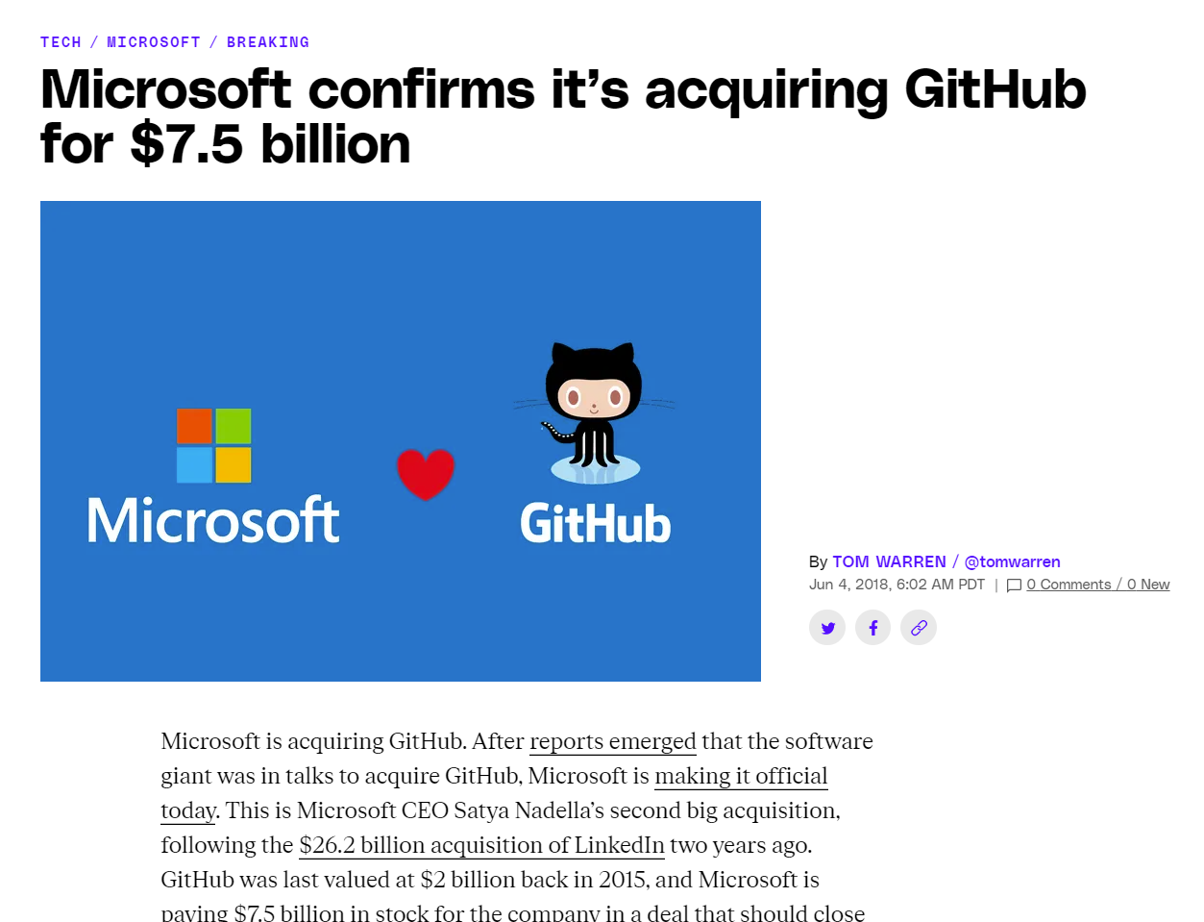
Btw
https://www.theverge.com/2018/6/4/17422788/microsoft-github-acquisition-official-deal
Notes:
Interoperability between programs
Why else?

Slide 15

Food for thought
Git is an open source tool developed by volunteers.
Why is Git free?
GitHub (and GitLab and Sourceforge) are for-profit companies that host our Git repositories for free.
Why is GitHub free?

Slide 16

Some meta-talk
Tech tools are like tax forms
Doing things the “normal way” is almost always good enough
Every once in a while it’s not, and you ask an accountant for help
Notes:
You don’t need to understand every single box on a form to file it

Slide 17
Let’s get our hands dirty

Slide 18
Some resources
Guide to getting started using Git and GitHub with GUI tools:
https://uwescience.github.io/graphical-intro-to-git/
Guide to getting started using Git through the command line:
https://swcarpentry.github.io/git-novice/
Git game:
https://ohmygit.org/
A cheat sheet from our old friend Wizard Zines:
https://wizardzines.com/zines/oh-shit-git/
Notes:
You don’t need to understand every single box on a form to file it

